Slide 1
FEED ME!!!

Slide 2
FEED ME!!!
Content Area: Health
Grade Level: 2
Summary: The purpose of this power point is to help learners identify the four basic food groups.
Learning Objectives: the learner will be able to list the four food groups and give examples for each.
Content Standard: 2
Accomplishments: students will be able to match foods to their food group.

Slide 3
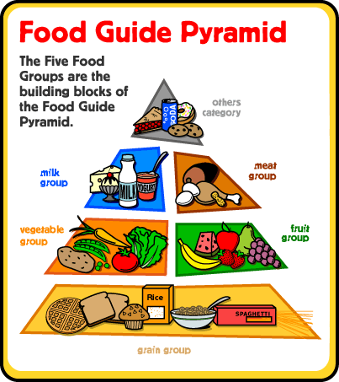
MY PRYAMID

Slide 4
basic Food Groups
DIARY
MEATS
BREAD
FRUITS and VEGETABLES
GRAINS

Slide 5
DAIRY
Examples: milk, yogurt, cheese

Slide 6
MEATS
Examples: chicken nuggets, fish, hot dogs

Slide 7
bREAD
Examples: biscuits, cornbread, rolls

Slide 8
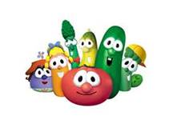
FRUITS and VEGETABLES
Examples: apples, carrots, bananas, broccoli

Slide 9
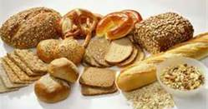
GRAINS
Examples: cereal, oats, rice

Slide 10
Fun with food
Now let’s play a game to see how much you know. Click any of the websites to apply what you have learned.
http://www.sheppardsoftware.com/nutritionforkids/games/foodgroupsgame.html
http://www.nutritionexplorations.org/kids.php
http://www.ehow.com/list_6521937_interactive-nutrition-games.html

Slide 11
review
Today we learned about the basic food groups and what foods are in each group.

